Slide 1

ET60012 FOUNDATIONS OF EDUCATIONAL TECHNOLOGY
Dr. Kaushal Kumar Bhagat
Centre for Educational Technology
Indian Institute of Technology Kharagpur

Slide 2
Current status, challenges and opportunities of Intelligent Tutoring System (ITS) in Developing Countries in Asia

Slide 3
Education in Asia
According to Asian Development Bank report (2011):
Education sector in Asia region is growing
More people have access to formal and informal learning
Notes:
More focus on upbringing the quality of education
More no of schools and colleges
More oppportunities

Slide 4
Challenges
Maintaining education quality
Improving curricular
relevance
Improving the usage of financial resources
Balancing expansion with greater equity

Slide 5
Brief History
1926 : A machine was first used to administer multiple-choice questions (Shute & Psotka,1994)
Mid-1950s: Rise of computers
1960s: Rise of computer-based programmed instruction (PI), CAI (Computer-assisted instruction), Intelligent CAI (ICAI)
Collaboration between education and Artificial Intelligence(AI)
These investigations gave rise to ITSs
1926
Rise of computers
1960s
A machine was first used to administer multiple-choice questions
1950s
Rise of computer-based PI, CAI, ICAI
Notes:
Let us go to the history of ITS
It simply presented questions , did not teach using learning theory
Difference between PI and CAI…. CAI follows behaviorist stimulus response psychology.

Slide 6
Definition
An ITS is a computer-based learning environment that makes use of artificial intelligence to create educational environments that respond to both the learner’s state and the instructional agenda (Graesser, Conley, & Olney, 2012).
Notes:
Artificial intelligence refers to the study of man-made computational devices and systems which can be made to act in a manner which we would be inclined to call intelligent.

Slide 7
Functions of ITS
Personalized hints
Guidance
Remediation
Emotional support

Slide 8
Issues addressed by this research
Map the Asian developing countries engaged in ITS research
Describe their research foci
Estimate the effectiveness of ITSs developed or deployed in these countries
Identify the limitations of current ITS research and opportunities for further study.

Slide 9
Four major components of ITS
01
A domain or expert model
03
A tutor or pedagogical model
02
A learner or student model
04
A user interface

Slide 10
A domain or expert model
It contains the following content which student is supposed to learn (Sottilare, Graesser, Hu, & Holden, 2013).
Skills
Knowledge
Procedures
Common errors
Misconceptions

Slide 11
A learner or student model
It contains the psychological states of leaners
(Sottilare, Graesser, Hu, & Holden, 2013).
Student emotion
Motivation

Slide 12
A Tutor or pedagogical model
Regulates the interaction between the student and the system.
Informed by both the domain model and the learner model, the tutor model selects the best teaching strategies.
Example : Cheng et al.’s (2014) Personalized Mathematics ITS

Slide 13
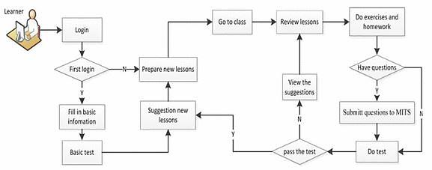
The flowchart of Cheng et al.’s (2014) Personalized Mathematics ITS

Slide 14
A user interface
Takes input from the learner and sends it to different models.
Receives output from the tutor model and displays it to the learner.
Example: Rodrigo et al.’s (2012) Scooter the Tutor.

Slide 15
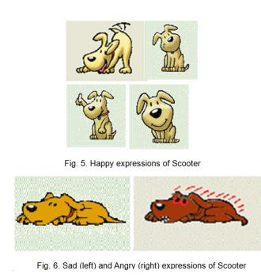
Scooter the Tutor
Notes:
Embodied conversational agent
Gaming the system: non learning behavior
Misuse of tutoring system example: repeated request for hints, guessing the answer
Proper use of ITS detects learning behavior

Slide 16
Data collection
Keywords used
intelligent tutoring system
achievement
effectiveness
learning outcome etc.
Data base used
Scopus, Web of Science, ERIC, Google Scholar and PsycINFO

Slide 17
Geography and foci of ITS Research in Asia

Slide 18
Theory-oriented ITS studies
Explain ITS architecture or augmentations or improvements to it, minus actual implementation.
Phobun and Vicheanpanya (2010), for example, describe the architecture and flow of an adaptive intelligent tutoring system (AITS).
AITS combines the features of an ITS with those of adaptive hypermedia.
Notes:
Adaptive hypermedia good for teaching declarative knowledge ( factual ex capital of Taiwan)
AITS problem solving process with materials in the form of adaptive hypermedia.

Slide 19
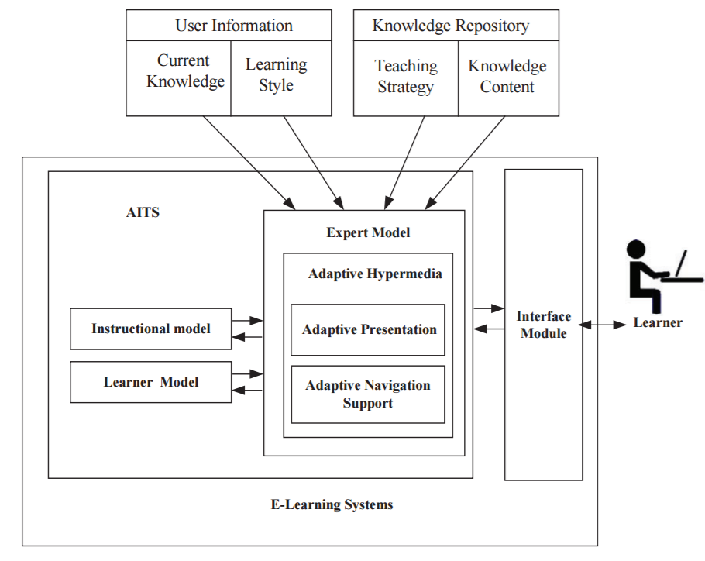
Phobun and Vicheanpanya (2010)’s AITS

Slide 20
Some theoretical papers to expand existing ITS by including new capabilities and features.
Sun et al. (2013), attempts to address ITSs’ lack of emotion, and how this shortcoming may undermine learners’ motivation and learning.
Describe how emotion recognition can be built into these systems.

Slide 21
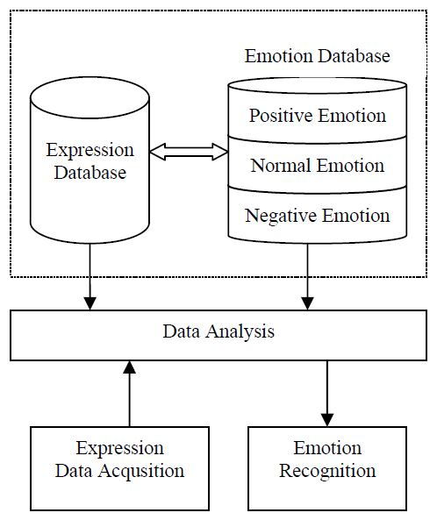
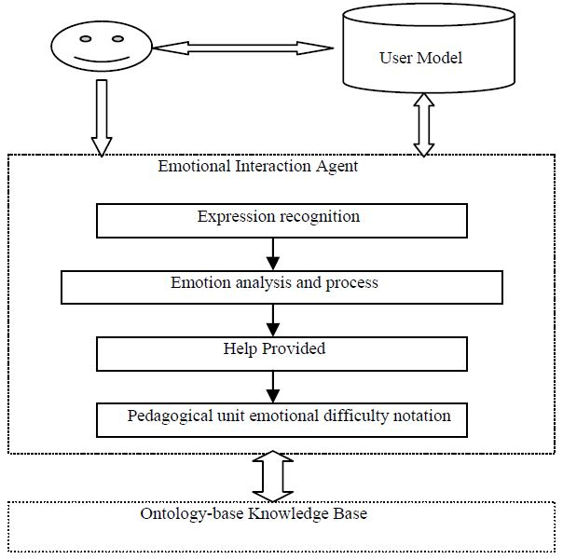
Sun et al.(2013) model
Notes:
A camera trained on student’s face then feeds facial expression

Slide 22
ITS development
Salinlahi (Regalado, et al., 2015)
ITS that teaches two type of exercises: translation and creation.
User interface: Responsible for interactions between the student and the system
Expert model: Two analyzers for each type of exercise
Student model: Represents what the student has and has not learnt
Tutor model: Tracks student attempts
Notes:
ITS for teaching Filipino grammar and sentence correction

Slide 23
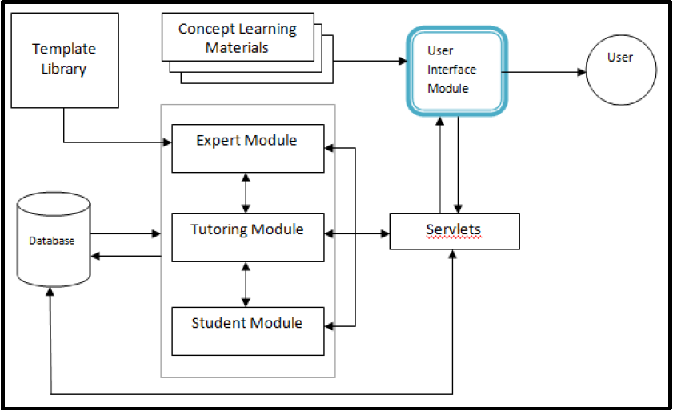
Regalado, et al., (2015)’s Salinlahi

Slide 24
Principles
Li, et al.’s (2010) ITS based on Multi-agent
To collect the basic information of students and analyze the characters of students according to the information.
To select the appropriate experimental teaching strategies and construct the specific virtual experiment.
To provide the virtual experiment for students through a virtual experiment environment
During the student's experiment, To provides real-time tracking for student’s operation and stepwise diagnosis, identify problems and give timely guidance.
To reconstruct the virtual experiment. Again provide to students. Thus, the process of an intelligent guidance of the experiment was completed.

Slide 25
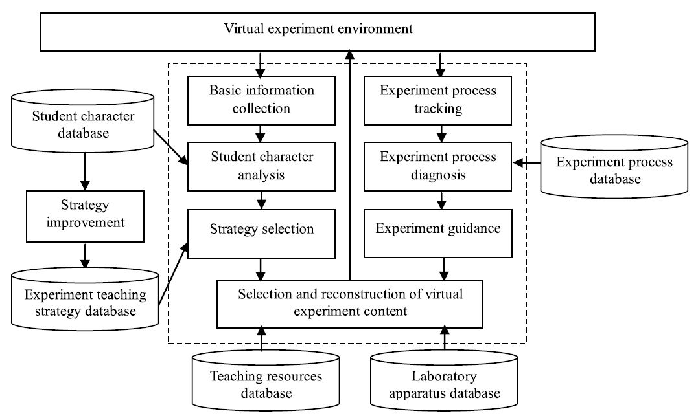
Li, et al.’s (2010) ITS based on Multi-agent
Notes:
Virtual experiment regarding light and reflection
Multiple agents : teacher agent , student agent
Students’ character

Slide 26
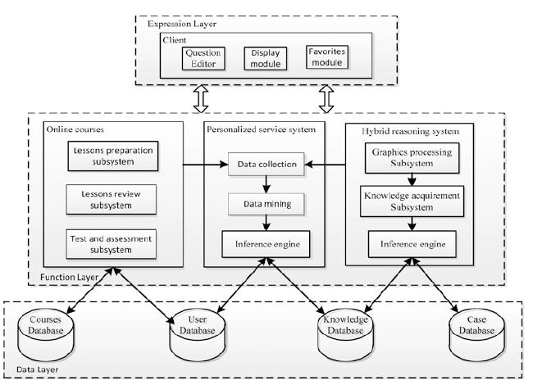
Cheng et al. (2014) ’s MITS architecture
Notes:
Expression layer equivalent to user interface as in the classical ITS architecture

Slide 27
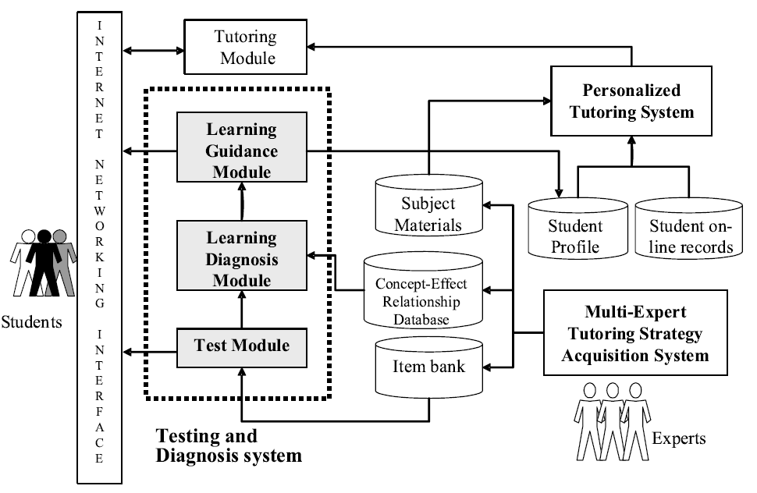
Hwang et al. (2008)’s ITED II

Slide 28
Inclusion criteria
Reported original data.
Samples were taken from Asia.
Compared learning outcomes from ITS learning environment with outcomes from a non-ITS learning environment
Sufficient quantitative data was presented to calculate effect sizes. Articles, in which the sample size for each group was not cited, were excluded.

Slide 29
Coding of study features
Grade level: Elementary School (1-6), or Secondary School (6-9), or High-school (10-12), or Undergraduate.
Types of Asian country: Developed, or Developing.
Subject domains: Mathematics, or Earth Science, or Computer Programming, or Others

Slide 30
Coded information of selected studies for meta-analysis

Slide 31
Results
Overall effects
p<.05
Overall weighted effect size is +0.570, with a 95% confidence interval of 0.114-1.026.

Slide 32
The learning-achievement effect sizes of categories and their related moderator variables
p<.05

Slide 33
Summary of Meta-analysis
Overall effect of ITS is better than the traditional mode of learning or not using ITS as an intervention, with a moderate effect size of 0.570.
Analysis of moderator variables showed that ITS have been used to various grade levels, types Asian country and subject domains.
The effect was greater for developing countries than developed countries.
Novelty effect may be the reason for better performance of ITS in developing countries than developed countries.

Slide 34
Why is this so?
Many schools in developing countries still lack infrastructure—electricity, telecommunications, and computer hardware (Nye, 2015)
Within-country differences are also stark. Urban areas adopt technology quickly, while remote areas cannot (UNESCO Institute of Statistics, 2014).
Lack of infrastructure is the lack of culturally-appropriate content (Nye,2015)
ITSs tend to be built in Western, industrialized, educated, rich, developed (WEIRD) countries (Blanchard, 2012).
Language and culture (symbols, contexts, situations, motivations) of the ITSs may not be a good fit for the target country’s students.
Student’s lack of technology skills
Notes:
Give my KVS example of one computer and 35 students
Within country example Delhi vs Guwahati

Slide 35
Opportunities for future research
Need to develop ITS beyond universal subjects
ITSs should also be designed for deployment on mobile phones and tablets, technologies that are far more ubiquitous than personal computers.
Attempt to maximize battery life by not being graphics-heavy and by minimizing the use of device components such as the camera, GPS, and accelerometer.
Deployment of already existing successful ITS
Effects of deployed ITSs should be monitored and studied.
Investigate the cross-culture influences
Notes:
Other than maths or science ITS on local language , culture , moral science

Slide 36
Gamification

Slide 37
Games Keeps Children Engaged for Hours
Design Right - Elements of Interest for a Good Game
Experience Design - Exploration, Hunting, Adventure, etc

Slide 38
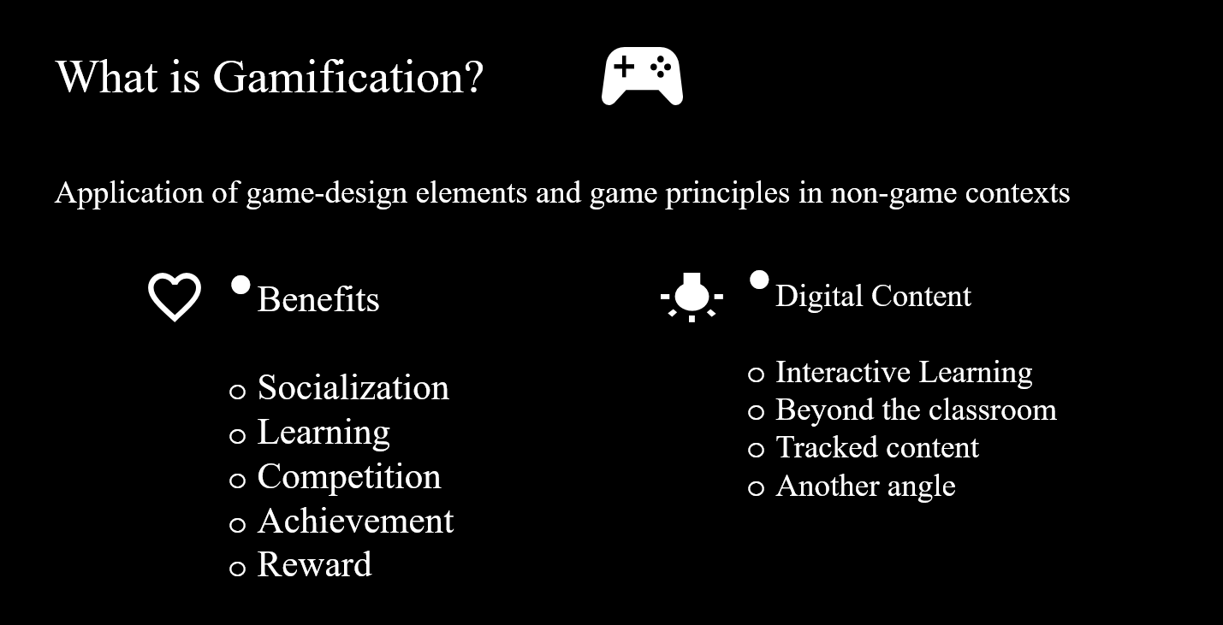

Slide 39
Mechanics
Fast Feedback : Immediate feedback or response to actions
Transparency : Where everyone stands
Goals : Short term and long term
Encourage users to continue or adjust their activities with onscreen notifications, text messages or emails.
Show users exactly where they stand on the metrics that matter to you and to your audience.
Missions or challenges give users a purpose for interaction, and educate users about what is valued and possible within the experience.

Slide 40
Mechanics
Badges : Evidence of accomplishments
Leveling up : Status within the community
Onboarding : An Engaging and compelling way to learn
An indicator of accomplishment or mastery of a skill is especially meaningful within a community that understands its value. Often used to identify skills and expertise within a group.
Levels indicate long-term or sustained achievement. Used to identify status within a community and to unlock new missions, badges, activities, and rewards.
Video games train you how to play as you play – users learn by doing. Simple missions help new users become engaged immediately as they master basic tasks, rather than being stumped by an unfamiliar interface or a detailed manual.

Slide 41
Mechanics
Points: Tangible, measurable evidence of my accomplishments
Used to keep score and establish status or accumulated to purchase virtual or real goods. Earn points through activities, sharing, contributing, or by creating something useful to others.
Competition: How I’m doing compared to others
Raise the stakes for accomplishing a goal by showing users how they compare to others, as individuals or in teams. Encourage competition with time-based, team and individualized leaderboards. Where do I rank? How can I overtake my closest competitor?
Community: A context for achievement
Collaboration: Accomplish a goal working with others
Community gives meaning to goals, badges, competitions, and other mechanics. Sharing participant achievements creates energy in the community by making people aware of what others are doing. They learn about goals, badges, and rewards that they may want to pursue.
Connect users as a team to accomplish larger tasks, to drive competition, and to encourage knowledge sharing. Show team members how they are contributing to the group’s success. No one wants to let down their team members.

Slide 42
